Slide 1
DIVERSify – Wheat-Faba Bean intercropping
Carolyn Mitchell, Alison Karley,
Adrian Newton and Cathy Hawes
Instructions
Click on the to read more information and then click on Back to return to the main page.
Start poster

Slide 2
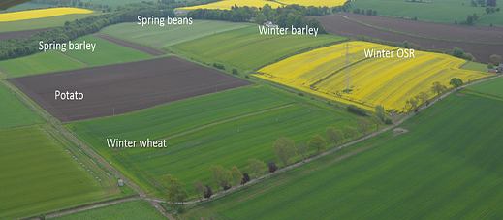
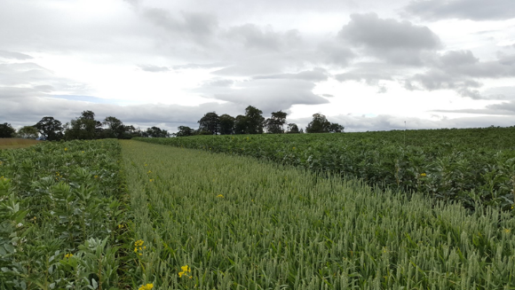
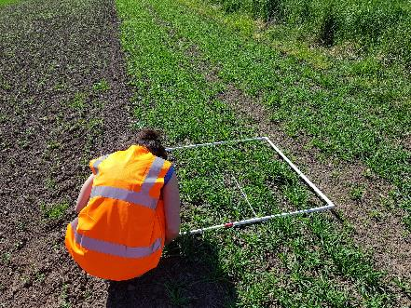
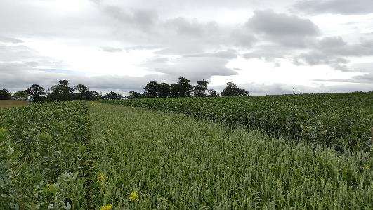
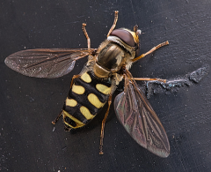
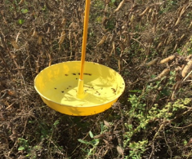
DIVERSify: Wheat-Faba Bean intercropping trials (2018 and 2019)
The DIVERSify project aims to optimise the performance of crop species mixtures (or intercrops) to improve yield stability, reduce pest and disease damage, and enhance stress resilience in agricultural systems.
The Centre for Sustainable Cropping
Trial layout at the CSC
Agronomic benefits
Yield benefits
The evidence is building to show that there
are consistent benefits to growing mixtures (intercropping) in low input systems.
These include benefits to yield, along with agronomic and environmental benefits.
Practical challenges include choosing suitable weed control and crop protection products along with equipment to harvest and separate grains for processing.
Intercropping video
Environmental benefits

Slide 3
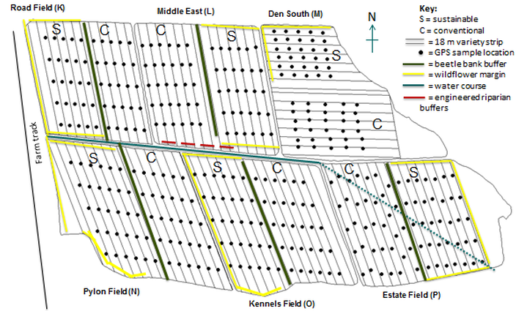
The Centre for Sustainable Cropping, Balruddery Farm, James Hutton Institute
The Centre for Sustainable Cropping comprises a 42 hectare block of six fields in the south-east of Balruddery Farm. The effects of integrated management with fewer inputs and direct drilling versus conventional management are tested using a split-field design over multiple six year rotations.
Each field was divided in half and the conventional or integrated cropping treatment was randomly allocated to either half. Each half field is subdivided into 2 main variety blocks with an additional 18 m strip available for plot-scale experiments. Across the whole site there are a total of 360 permanent GPS locations at which key arable systems indicators are surveyed throughout each growing season.
For more information about the CSC go here.
Back

Slide 4
Experimental setup in 2018 and 2019
The mixture strips were sown at a 50% rate of their standard density.
Wheat = Tybalt
Bean = Boxer
In both years, 6 strips were sown in each of the conventional plot strip and the integrated plot strip – 2 mixture strips and 2 monoculture strips of each species.
A (C)
B (S)
Plot strip
A (S)
B (C)
V1
A (S)
Plot strip
V1
V2
V2
V1
V2
V2
Plot strip
V1
V2
V1
Plot strip
Plot strip
V2
B (C)
V1
Plot strip
A (S)
B (C)
A (S)
B (C)
Plot strip
A (C)
B (S)
V1
V2
V2
V1
Plot strip
V1
V2
V1
Experimental setup in 2019
Plot strip
V2
Plot strip
V1
V2
V2
V1
Plot strip
Plot strip
18 m
18 m
2019
2018
1. Bean
2. Bean-Wheat
3. Wheat
4. Bean
5. Wheat
1. Bean
6. Bean-Wheat
2. Bean-Wheat
3. Bean
4. Wheat
5. Wheat
6. Bean-Wheat
Trials were monitored for crop development, canopy and individual plant characteristics, soil variables and pest and disease incidence using the project protocols.
3 m
3 m
Kennels field A (Integrated)
wheat-bean
Kennels field B (Conventional)
wheat-bean
Back

Slide 5
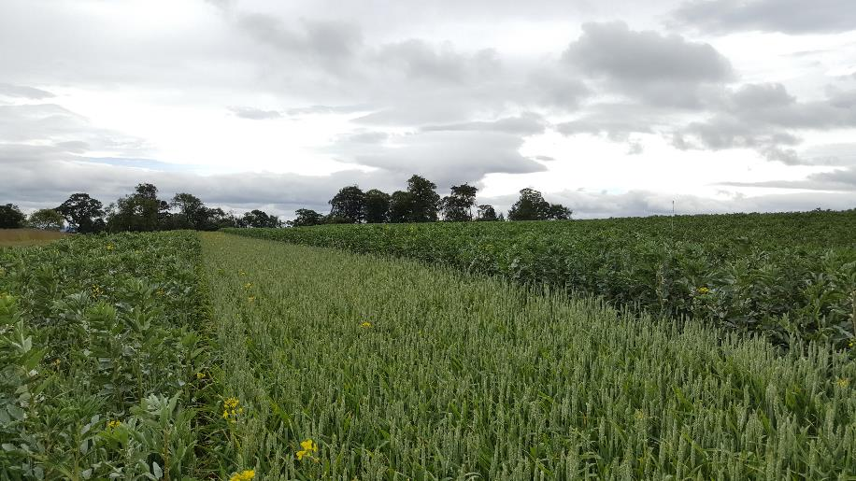
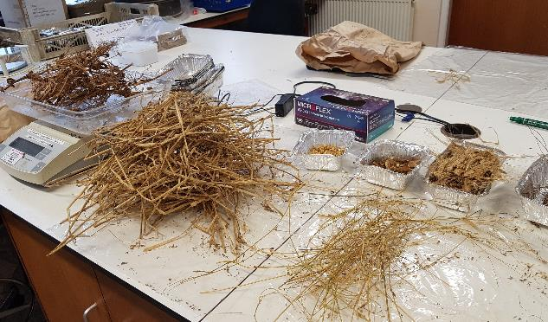
Yield benefits depend on management
percentage increase in yield when grown in a mixture compared to monoculture | conventional | integrated
bean | -2% | 57%
wheat | -20% | 28%
The table shows the yield data collected for the wheat-faba bean trial in 2019.
This has been calculated from biomass samples taken at 3 points along each strip.
There are different effects depending on the management type (conventional versus integrated).
The relative yield of wheat and faba bean (g m⁻²) was higher when intercropped compared with monocultures, but only under integrated management.
Weighing biomass in the lab
Back

Slide 6
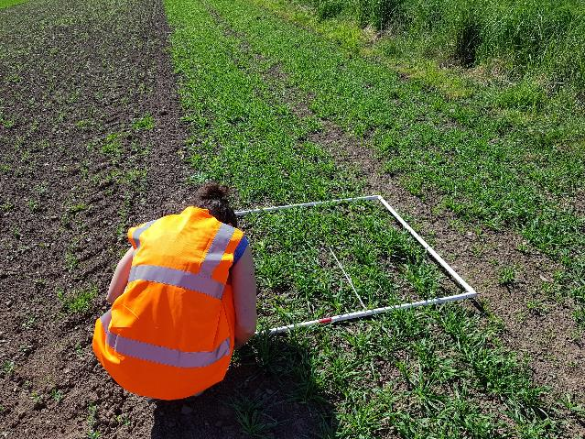
Agronomic benefits – weeds and soil fertility
This table shows the percentage of weed and ground cover for 2018 and 2019 trials combined. Weed and bare ground cover were obtained by estimating the %ground covered in a 1m² quadrat at 5 sampling points in each strip.
There are some consistent benefits to growing mixtures associated with weed control. Weed biomass is reduced when legumes are grown with cereals when compared with legume monocultures and this is due to better ground cover by the crop vegetation.
 | Crop species/management type | increase˄ or decrease˅ when grown as a mixture | percentage difference
weed cover | wheat conventional | ˄ | 82
 | bean conventional | ˅ | 66
 | wheat integrated | ˄ | 43
 | bean integrated | ˅ | 39
bare ground cover | wheat conventional |  | 0
 | bean conventional | ˄ | 16
 | wheat integrated | ˅ | 38
 | bean integrated | ˄ | 62
Enhanced soil fertility (soil phosphate availability) was was found in the integrated management and the soil fertility was also greater in the mixture strips with conventional management.
Samples collected in 2018 are being analysed for soil microbial composition to understand the link between soil fertility and crop management.
Back

Slide 7
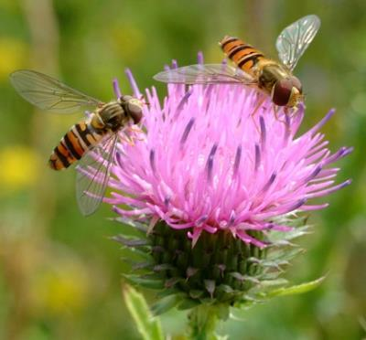
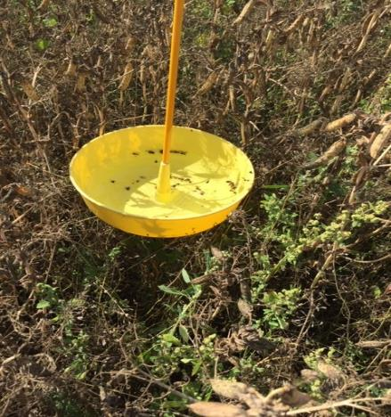
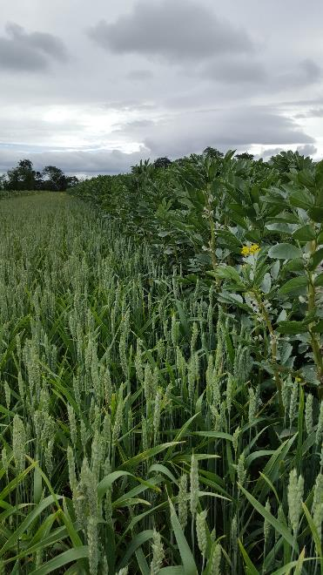
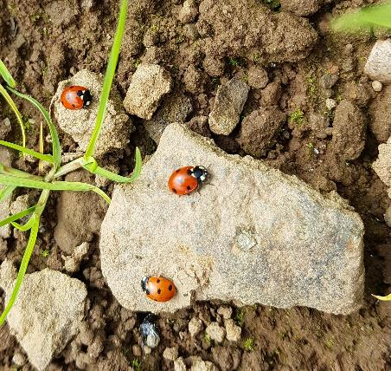
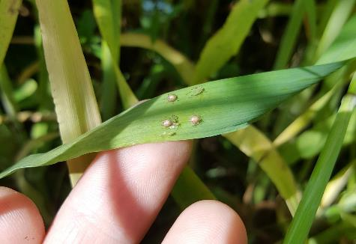
Environmental benefits - pests and their natural enemies
Insect surveys were done in 2018 where the number and species of each insect found on 5 bean plants and 30 wheat tillers was recorded.
Pan traps were put out for 24 hours with 2 pan traps per strip. The insects caught were identified and counted.
The number of hoverflies differed between management types with significantly higher abundance in the integrated management than the conventional management treatment.
Aphid density was found to be lower under integrated management.
Back

