Slide 1
Key Products 2020
For Arable Scotland Event

Slide 2
Our purpose -
An open agriculture network that feeds sustainable growth for all. No limits, no borders!
Learn more about what this means for our stakeholders, visit www.upl-ltd.com
Open Access
Open Innovation
Open Intel
Open Collaboration
Open Markets
Open Hearts

Slide 3
We say potato

Slide 4
Fungicides for potatoes
UPL is one of the largest manufacturers of potato fungicides with many different actives, and producers of the market’s best selling in field potato sprout suppressant, FAZOR®
We understand that growers face new challenges from an unpredictable climate causing water management issues, the loss of key chemistry due to regulatory changes, and disease resistance to chemistry that is still available. Yet quality and economics of the crop is more important than ever. That’s why we’ve been working hard to protect our product portfolio, and to develop new and innovative biostimulant, biocontrol and PGR products to help growers overcome some of the challenges, and produce great crops.
Click here to download a pdf of our full potato product brochure or to hear about just some of our key potato fungicides watch this short video

Slide 5
Hi IODUS

Slide 6
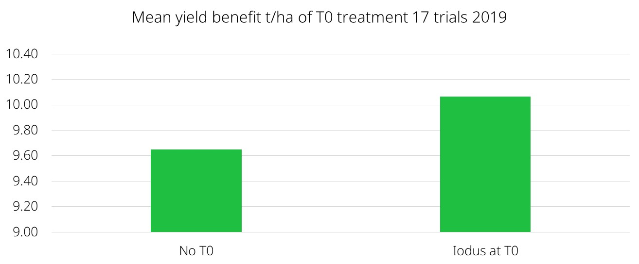
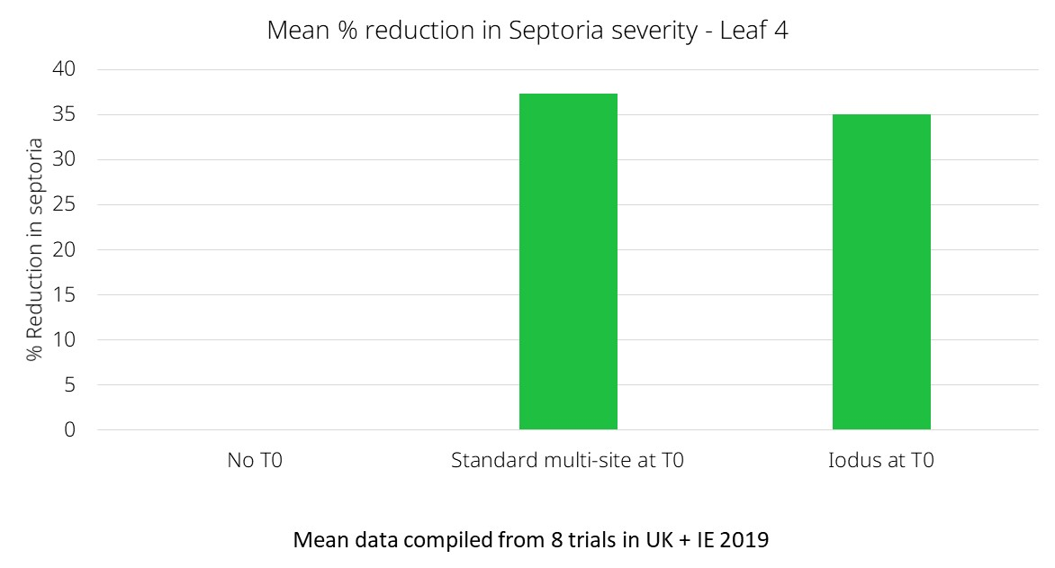
NEW – IODUS® (MAPP 19163)
Introducing IODUS®, a brand new registered bio fungicide. IODUS acts by elicitation of the crops natural defence mechanism against septoria and powdery mildew, and has some evidence of yellow rust control.
It contains Laminarin, a natural plant extract.
Active (s) | g a.i./l | Crops | Max. no. apps | Max. ind. dose | Max. total dose | Buffer zone
Laminarin | 37.5 | Winter wheat | 1 | 1l/ha | 1l/ha | -
To learn more about IODUS, what it is, and how it works, click here to view a short aminated video.

Slide 7
Sulphur so good

Slide 8
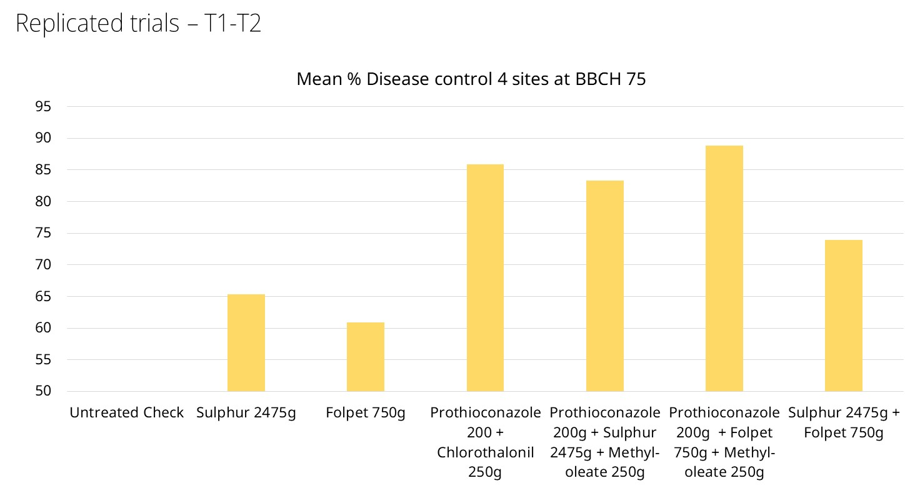
THIOPRON (MAPP 19147)
THIOPRON is a new and innovative liquid formulation of sulphur, which is registered as effective multisite fungicide.
Whilst sulphur is not a new concept (it’s been used on vines since Roman times!) this highly engineered liquid formulation contains small and homogeneus particles which create a larger surface area than typical dry or fertilizer grade products.
The sulphur active works by transitioning to a gas state, combining with hydrogen in the atmosphere to create a layer of Hydrogen Sulphide (H2S) gas on the leaf. This gas is toxic to fungal pathogen infections, causing curative effects and toxifying the surface of the leaf to help prevent the establishment of spores.
Active (s) | g a.i./l | Crops | Max. no. apps | Max. ind. dose | Max. total dose | Buffer zone
Sulphur | 825g/l | Barley, oats, rye, triticale, wheat, | 2 | 9.7l/ha | - | 5m Arthropod buffer
Can be applied from BBCH 31-59 to form part of a post CTL disease control strategy
Offers a viable IPM/zero residue alternative in light of growing UK requirements for such products

Slide 9
Flower power

Slide 10
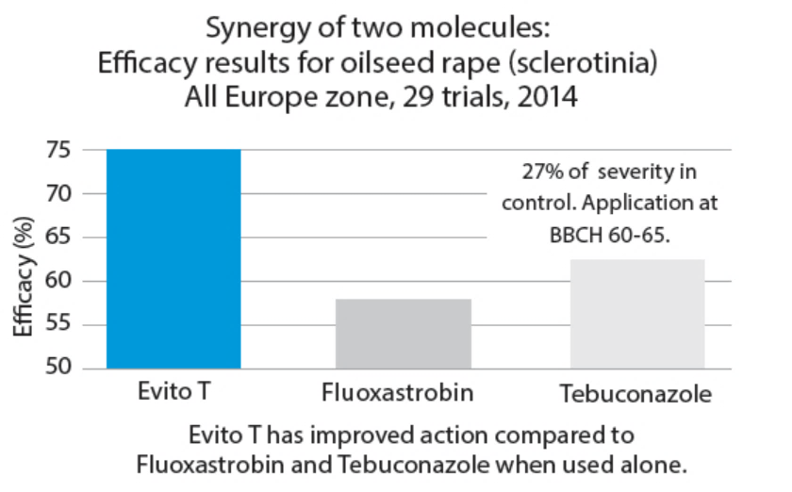
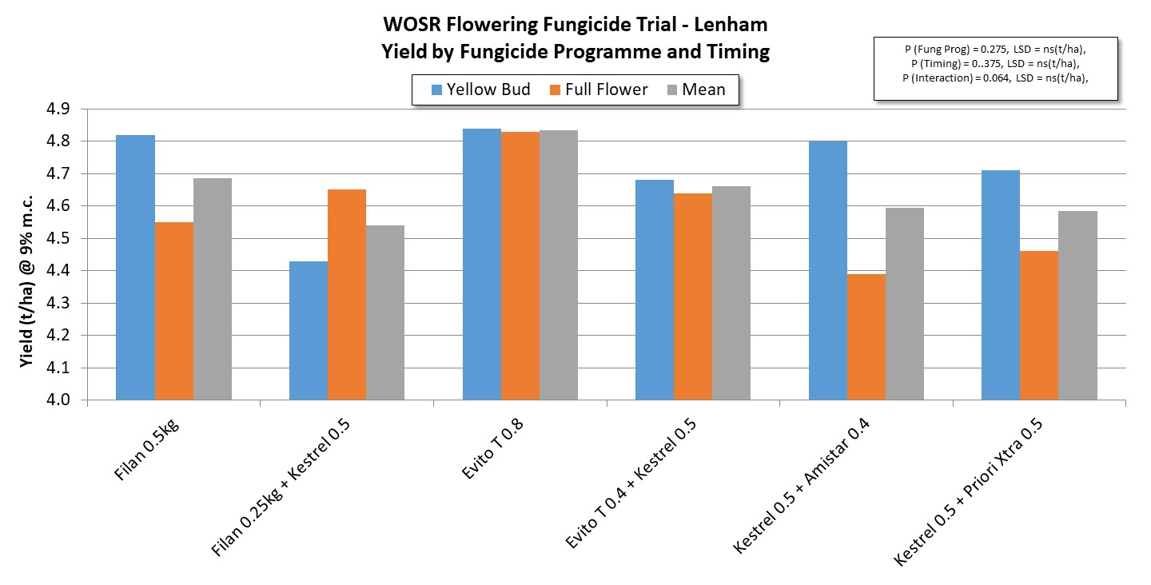
EVITO-T
EVITO-T is a highly advanced strobilurine fungicide for excellent control of sclerotinia in flowering oilseed rape.
It contains 2 powerful active ingredients (fluoxastrobin and tebuconazole) that combine to deliver a highly systemic, long lasting and reliable result. It is rainfast in as little as 15 minutes, and offers residual soil activity and rapid root uptake.
For more information about EVITO-T please visit www.upl-ltd.com/uk/product-details/evito-t, or read this blog from UPL’s Business Manager in Scotland, Geoff Hailstone

Slide 11
Quiz

Slide 12
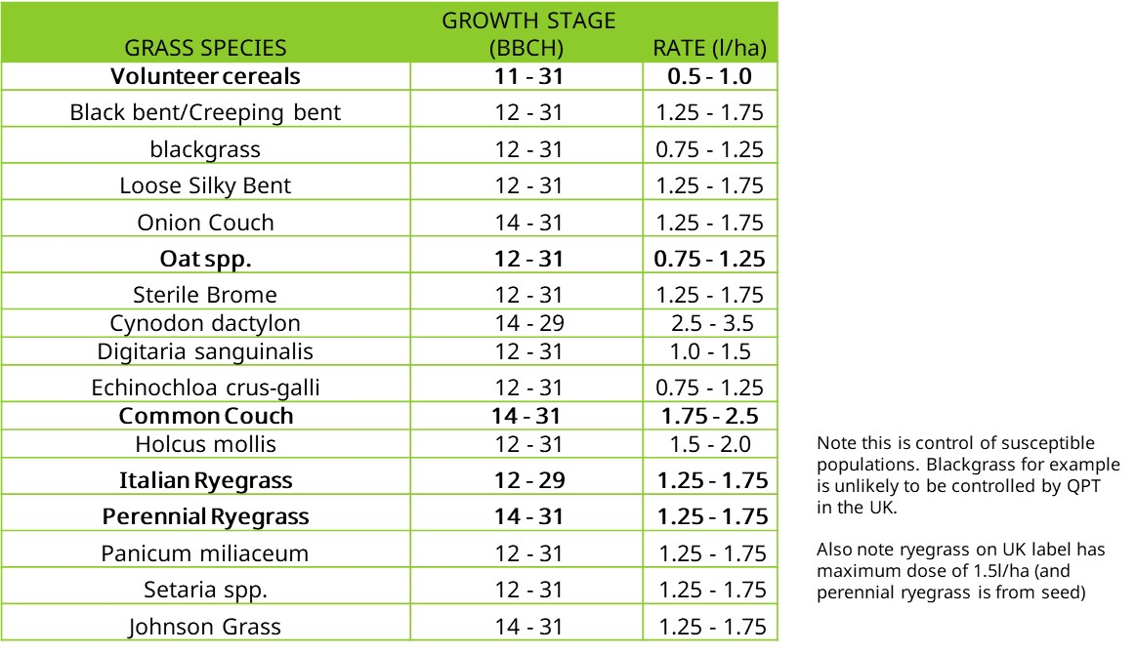
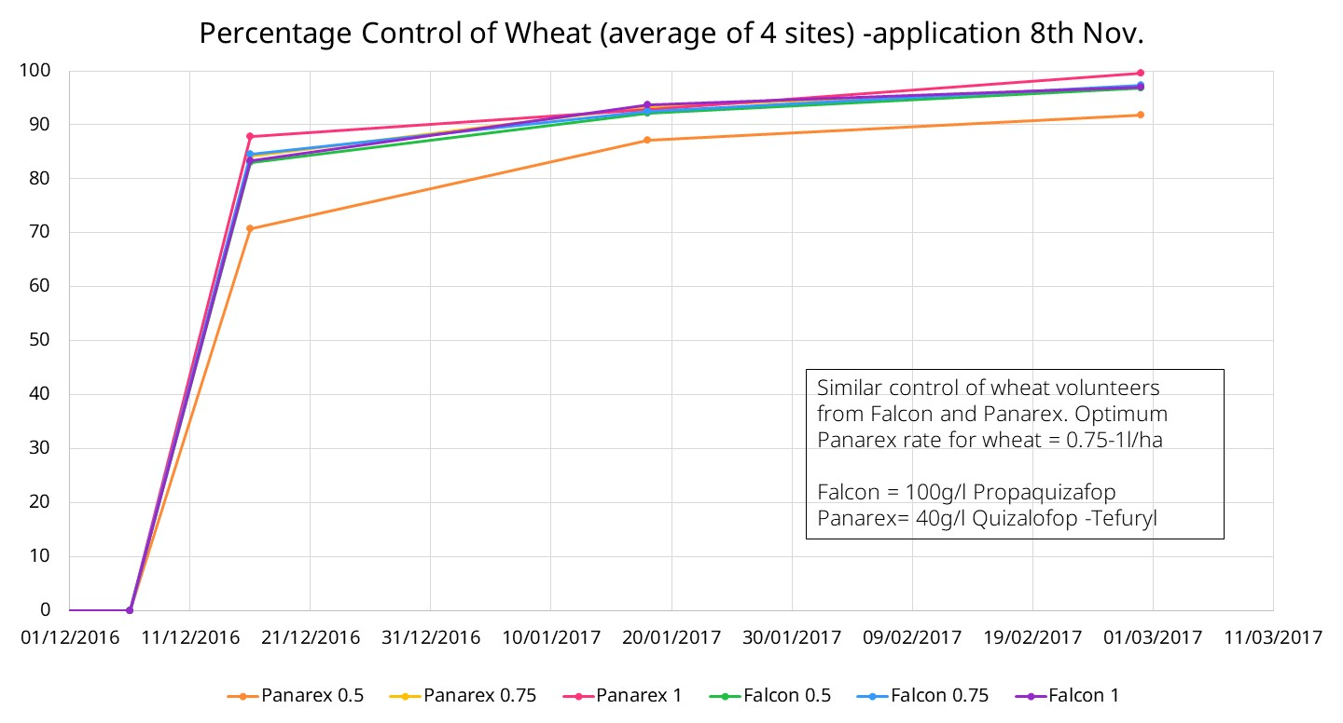
RANGO (17959), PANAREX (17960)
RANGO and PANAREX offer grass weed control of species such as volunteer cereals, couch and rye grass in several crops including OSR, potatoes, and linseed. These products offer a flexible dose rate according to weed population
 | g a.i./l | Crops | Max. no. apps | Max. ind. dose | Max. total dose | Buffer zone
Quizalofop-P-Tefyl | 40 | Oilseed rape Sugar and fodder beet Potatoes Combining pea Field bean Linseed | 1 | 2.25l/ha | 2.25l/ha | -
For more information about RANGO or PANAREX please visit the product information pages

Slide 13
Contact us

Slide 14
UPL technical team
Scotland & North East England
Geoff Hailstone
Business Manager- Northern Britain
Grassland Crop Specialist
Geoff.hailstone@upl-ltd.com
Tel: 07780 707173
North West, West Midlands, Wales & Ireland
Don Pendergrast
Head of Technical Services
Arable Foliar Lead (Fungicides, Insecticides, PGRs & Biostimulants)
Potato and Cereals Crop Specialist
Don.pendergrast@upl-ltd.com
Tel: 07795 572037
Yorkshire & East Midlands
Rob Adamson
Technical Specialist
Seed Treatment and Arable Herbicide Lead
Oilseeds and Pulses Crop Specialist
Rob.adamson@upl-ltd.com
Tel: 07584290293
UK & Ireland
Stephen Olive
Business Development Manager
Specialty and Amenity Technical Specialist
Stephen.olive@upl-ltd.com
Tel: 07341 566356
East Anglia
Pam Chambers
National Influencer Lead
Sugar Beet and Field Veg Crop Specialist
Pam.chambers@upl-ltd.com
Tel: 07809 227583
South East & South West
Greg Hanna
Technical Specialist
Trials and R&D Lead
Fruit Crop Specialist
Greg.hanna@upl-ltd.com
Tel: 07341 864907
National Technical Helpline: 01482 231772

Slide 15
www.upl-ltd.com/uk. E: info.uk@upl-ltd.com @UPL_UK
To receive our Technical Newsletter updates, please sign up here.
Download the new UPL Blight Forecast App, available now for smartphone users. Visit your app store or click here for android, or here for iOS.

