Slide 1
Limagrain UK Wheat Breeding 2020

Slide 2
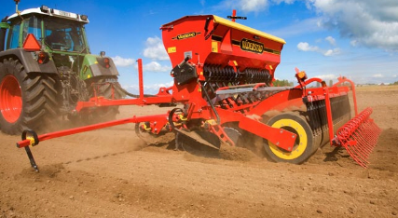
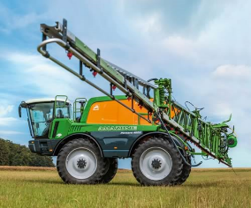
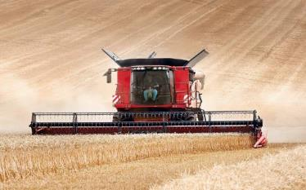
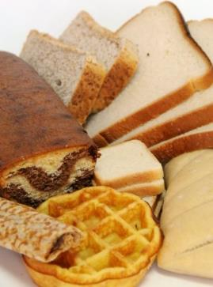
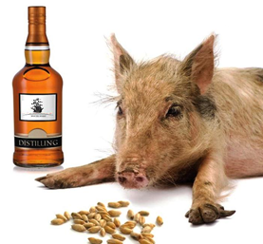
Breeding Objectives
Grower requirements
Consistency of yield and quality
Ease of production
Marketable product
High quality variety advice
End User requirements
Reliable quality
Consistent supply
Ease of processing
Economically sourced

Slide 3
External Factors affecting Breeding
Environmental
Seasonal variability/unpredictability
Frequency & severity of epidemics
Sub-optimal timing for inputs
Technological
Precision Agriculture
End user processes or new markets
Novel breeding technology
Legislation
Food quality regulations
Agrochemicals (e.g. Chlorpyrifos)
Nitrate sensitivity
New breeding techniques (GE)

Slide 4
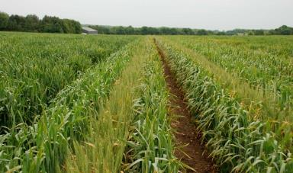
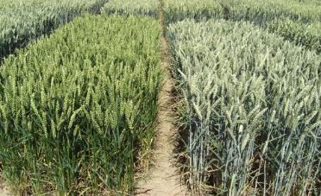
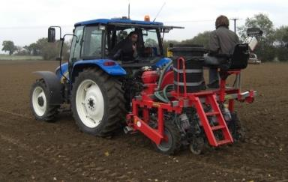
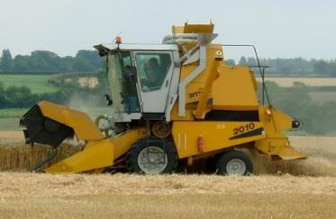
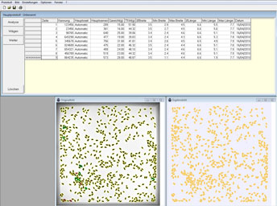
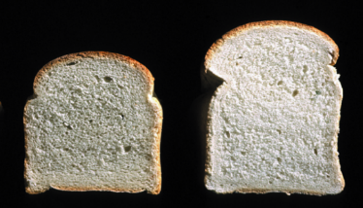
Traditional Breeding Approaches
Field Assessment
Disease
Plant type
Agronomy
Yield Assessment
Automated drilling
Precision spraying
On combine weighing
Post-Harvest Assessment
Grain quality
Predictive testing
End product quality

Slide 5
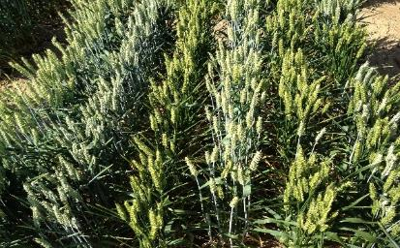
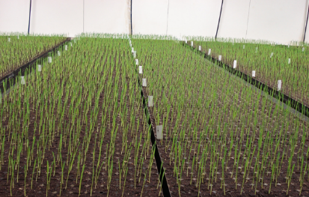
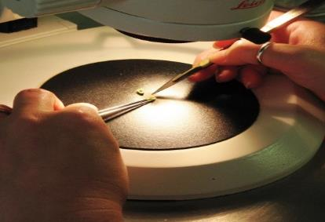
Main Breeding Methods
Pedigree
Traditional method
One generation per year, 10 years to market
Large programme, maintains diversity but slow
Single Seed Descent (SSD)
2 or 3 generations in a year
Requires growth room or glasshouses
Saves 1 to 2 years
Double Haploids (DH)
Fixes the new variety in one step
Requires tissue culture expertise
Fastest route, saves 2 to 3 years

Slide 6
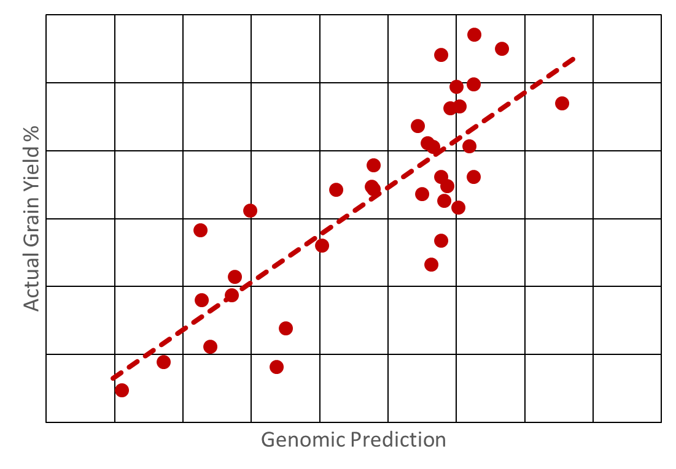
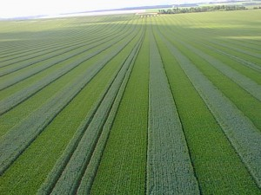
New Breeding Systems
Genomic Selection
Used in commercial crop and animal breeding
Requires high density marker system
High computational demand
Potential to increase the rate breeding gain
F₁ Hybrids
Gain from hybrid vigour (heterosis)
Requires cost effective seed production system
Chemical emasculation method available
Genetic solution is more desirable

Slide 7
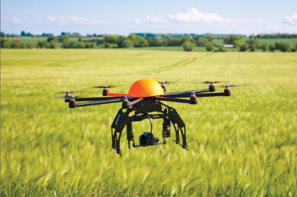
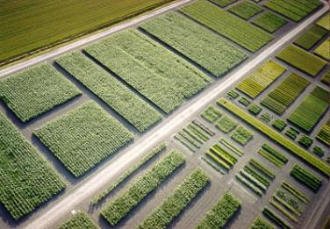
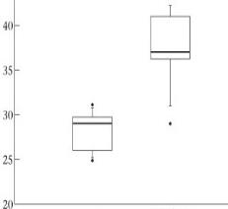
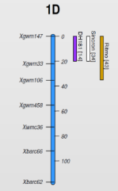
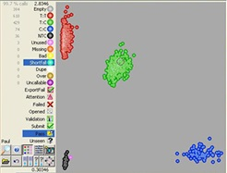
Modern Breeding Technology
Phenotyping
Diseases and physiology
Whole crop or single plants
Automated systems
Small plot estimates of yield
Genotyping
Simple single genes of large effect
Marker Assisted Breeding
Complex multi-genes of small effects
Genome wide analysis
AA TT

Slide 8
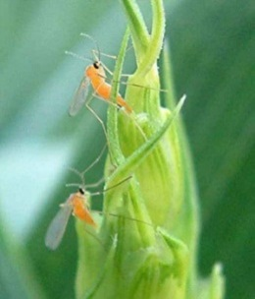
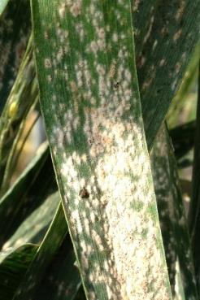
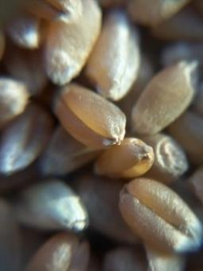
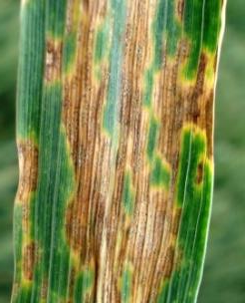
Genotyping - Single genes of large effect
Increasing catalogue of commercially important genes
Disease resistance
Agronomic traits
Elements of grain quality
Yield (grain size)
Marker Assisted breeding
Profiling parent varieties
Selecting crosses
Intense early stage selection
Stacking novel gene combinations

Slide 9
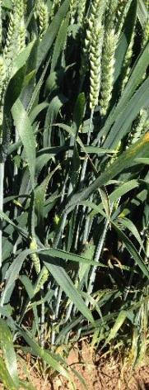
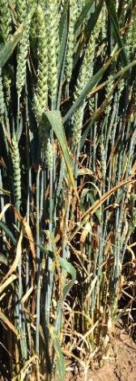
Septoria tritici
Major yield robbing disease
Loss of fungicide efficacy
Threat of fungicide withdrawals
Multiple sources of resistance identified
Commercial UK varieties
Pre-commercial breeding lines
Continental varieties
DNA markers available and in development
Requires screening in multiple high disease locations
High density mapping
Priority to stack multiple sources together
Limit the risk of breakdown

Slide 10
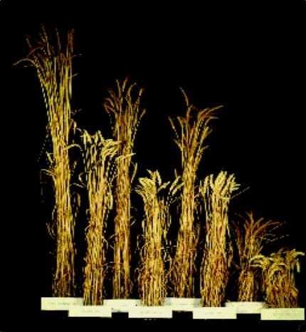
Genotyping - Multiple genes of small effect
Complex traits
Yield
Quality
Complex disease problems
Genome wide analysis
Greatly increased marker density
Higher resolution mapping
Investigate in detail the genetics of both current and historic varieties

Slide 11
Soft Wheat Classification
Understanding the market and working with End Users
KWS Barrel
KWS Basset KWS Firefly
Group 3 Biscuit
Elicit
Zulu
Revelation Viscount
Elation
Leeds
Bennington
LG Skyscraper
LG Spotlight
LG Sundance
LG Motown KWS Jackal
Group 4 Soft
Good Distilling
Medium Distilling
LG Varieties
Notes:
Potentially the only variety in the top 3 categories for G3, uks & good distilling.

Slide 12
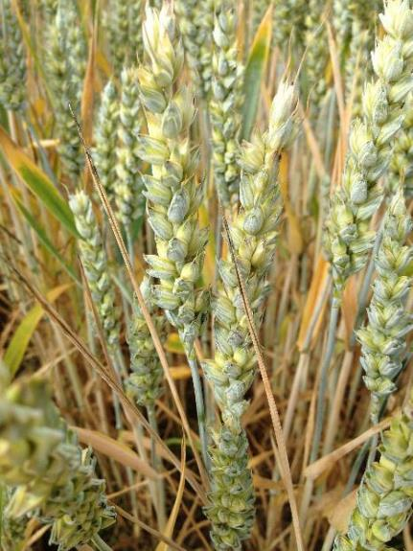
Frost Damage and Sterility
Reducing risk factors for growers

Slide 13
Integrated Breeding Platform
Market Analysis
Gene discovery and validation
Phenotyping technology
Market Driven Objectives
Intensive Genotyping
Intensive Field Evaluation
Limagrain Wheat Breeding Process
Selected Parental Germplasm
Accelerated Breeding
End Use Evaluation
Wide Genetic Resources Pool
Adapted DH & SSD methods
Enhanced Predictive testing

Slide 14
The Breeding Challenge
Anticipation of market requirements
Understand future needs of both the Growers & End-Users
Consideration of multiple external factors
Clear breeding objectives
Integration of Research & Development into the Breeding pipeline
Evaluate new methods, tools, techniques & traits
Continually improve breeding efficiency by maximising the benefit of these new developments to maintain a constant flow of commercially successful varieties

