Slide 1
Malting Quality in Winter Barley

Slide 2
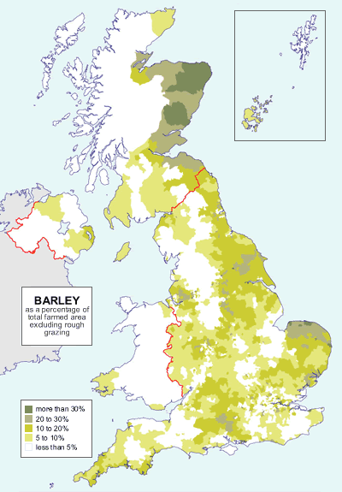
UK barley production & use
https://www.gov.uk/government/collections/cereal-usage-and-stocks

Slide 3
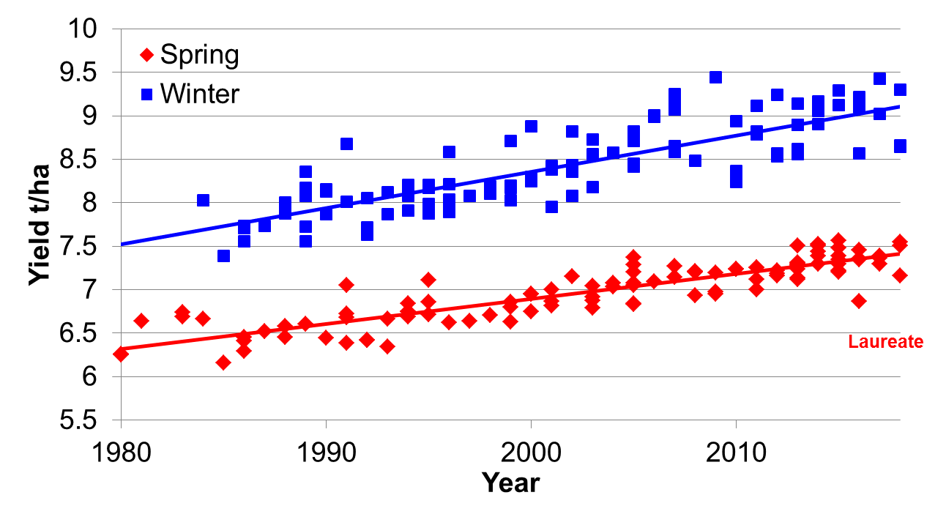
Breeding progress for yield
Retriever
KWS Orwell
Sequel
Pearl
Pastoral
Manitou
Panda
RGT Planet
Triumph
NFC Tipple
Chariot
Optic
Concerto
Data derived from analysis of UK NL & RL data (BSPB & AHDB)

Slide 4
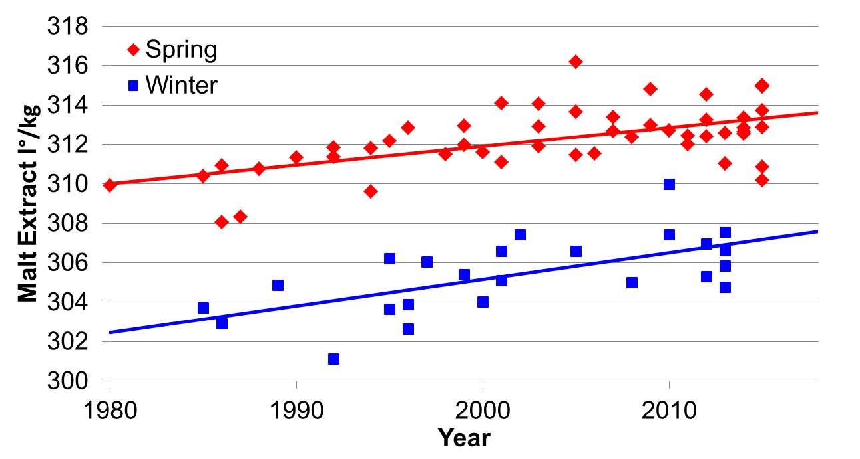
Breeding progress for malt extract
Overture
Westminster
Optic
Concerto
Sienna
Chariot
Triumph
Winsome
SY Venture
Pearl
Talisman
Fanfare
Halcyon
Data derived from analysis of UK NL & RL data (BSPB, AHDB & MAGB)

Slide 5
Scottish Malting Barley Purchases
Data from MAGB Annual Survey of Barley Purchases

Slide 6
Recommended List Relations
Winter
Spring
2 Row
6 Row
Malt
Feed
Kira
Igri
Pict
Hart
Golf
Opal
Intro
Rifle
Epic
Kym
Cork
Flute
Haka
Atem
Optic
Pearl
Carat
Frolic
Static
Chad
Spire
Kirsty
Sprite
Scylla
Puffin
Magie
Sumo
Linnet
Jewel
Midas
Alexis
Heron
Jolika
Cellar
Troon
Gaelic
Gypsy
Firefly
Colibri
Tyne
Dandy
Power
Doyen
Tipple
Pipkin
Panda
Gleam
Willow
Target
Felicie
Chime
Wicket
Leonie
Flagon
Digger
Carafe
Hanna
Accrue
Fighter
Kestrel
Sequel
Siberia
Riviera
Klaxon
Zephyr
Prisma
Pewter
Tavern
Saloon
Angela
Regina
Angora
Vertige
Saffron
Torrent
Bronze
Clarine
Pelican
Muscat
Delibes
Cooper
Chariot
County
Tocada
Sunrise
Fanfare
Avenue
Antonia
Gaulois
Chalice
Camion
Prelude
Heligan
Century
Marinka
Melanie
Halcyon
Finesse
Manitou
Plaisant
Georgie
Triumph
Cocktail
Prestige
Quench
Cassata
Pastoral
Forester
Natasha
Tankard
Waggon
Melusine
Vanessa
Wintmalt
Retriever
Diamond
Cannock
Posaune
Amarena
Derkado
Corniche
Brewster
Landlord
Publican
Rebecca
Blenheim
Decanter
Concerto
Oxbridge
Sweeney
Spectrum
Aquarelle
Camargue
Appaloosa
Belgravia
Maris_Otter
Golden_Promise
Westminster
IBD Accepted

Slide 7
Malting quality from Maris Otter
Pioneer
Proctor
Igri
Athos
MarisOtter
W
arboys
Sergeant
Cross1
Finesse
Torrent
Puffin
Angora
Halcyon
NRPB87/5378
Pipkin
T
Fanfare
Rifle
NFC296-7
NSL96-7157
Opal
Pearl
Cross2
Cross3
Cross4
Cassata
DH7169-01
Flagon
Wintmalt
Accrue
Saffron
Winsome
Retriever
KWS Joy
Soloman
Mezmarr
Talisman

Slide 8
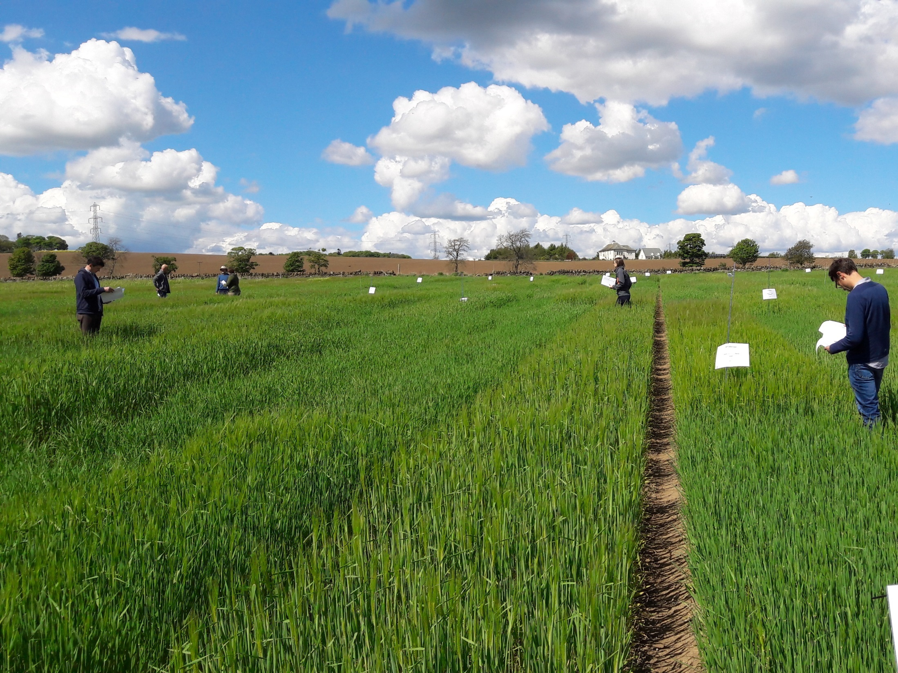
IMPROMALT
Collaboration with commercial breeding companies
Also MAGB & SWRI
Use of genetic fingerprinting platforms developed by Hutton
Together for pre-competitive research
BBSRC/AHDB IMPROMALT project

Slide 9
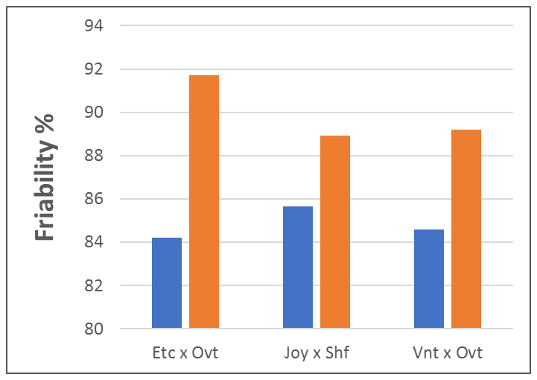
Results of IMPROMALT project
Spring
Winter
Without
With Spring Regions
Key spring malting quality regions introduced by backcrossing into winter varieties
Consistent increase in HWE and modification traits

Slide 10
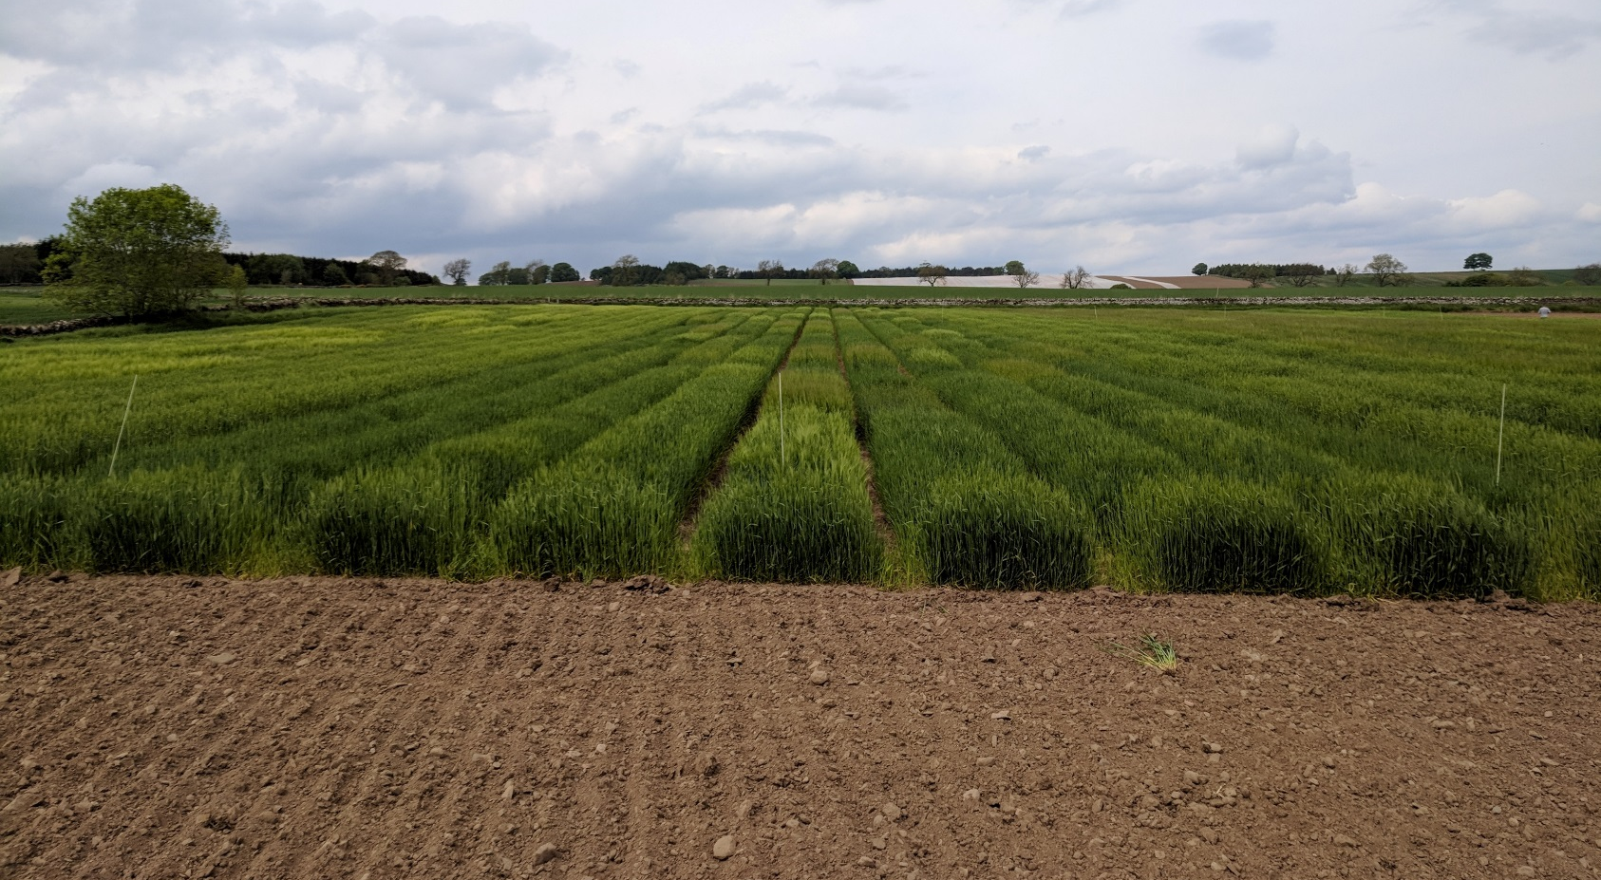
Summary
UK Winter barley varieties have lower malting quality than spring varieties (but better yield)
Winter quality stems from past winter x spring crosses (Maris Otter)
Recent IMPROMALT project used winter x spring crosses to further improve winter malting quality

Slide 11












Thanks

